Slide 1
INTRODUCTION TO THE CONSTITUTION OF INDIA
Surya Saxena
Assistant Professor of Law

Slide 2
GENERAL INTRODUCTION
The Constitution of India was brought into force on 26 January 1950 announcing the birth of a new republic to the entire world.
It is the Supreme Lex, it reflects upon the struggle and aspirations of the people of a country which was subjected to the oppressive rule of a colonial power for more than two centuries.
The Constitution of India is also known as the father of all laws i.e., grundnorm as all the other existing laws get the effect and drive their force from the constitution itself.

Slide 3
Constitutional law in the generally accepted terms means the rule which regulates the structure of the principal organs of the Government and their relationship to one another and determines their principal functions.
The rules, consist both of legal rules in the strict sense and of usages, commonly called conventions, which without being enacted are accepted as binding by all who are concerned in the Government.
The Constitution is the very basis on which the laws of the country gain sanctity. The Constitution is the living document, whose interpretation may change as the time and circumstances change.
It is an elaborate document and contains 395 articles (divided into 22 parts) and 12 Schedules)

Slide 4
It took almost three years (two years, eleven months and eighteen days to be precise) to complete the historic task of drafting the Constitution for Independent India. The Constitution of India was adopted on 26 November 1949 and the Hon’ble members appended their signatures on it on 24 January 1950.
A Constitution means a document having a special legal sanctity which sets out the framework and the principal functions of the organs of the Government of a State and declares the principles governing the operation of those organs.

Slide 5
MAKING OF THE CONSTITUTION
Constituent Assembly of India sat for the first time on December 9, 1946.
Thus started a historical journey which saw India attainting independence, deciding on its national flag, national insignia, national anthem; and ultimately adoption of the Constitution which made our country a democratic republic.
Salient features of the Constituent Assembly –
A. The Constituent Assembly of India came into existence as per the provisions of Cabinet Mission Plan of May 1946.
Its task was to formulate constitution/s for facilitating appropriate transfer of sovereign power from British authorities to Indian hands.

Slide 6
B. The Assembly was to have proportional representation from existing provincial legislatures and from various princely states.
Bulk of these elections was completed by the end of July 1946, under the supervision of Reforms Office under Governor General (Viceroy).
C. The Assembly was to have three sections: Punjab & North-West, Bengal-Assam and Rest of India.
The Constitutions were to be formulated for Indian Union, each Section and for each of the Provinces therein.
The Muslim League, which had won bulk of the 80 Muslim seats and dominated two smaller Sections, chose not to participate so the Assembly never convened separately in sections.

Slide 7
D. The Assembly took help of several non-members in formulation of the Constitution.
Eminent public figures outside the Assembly were requested to work as members of committees formed by the Assembly for focused deliberations on specific features or segments.
E. The Constituent Assembly appointed a total of 13 committees to deal with different tasks of constitution-making. Out of these, eight were major committees and the others were minor committees.

Slide 8
F. The Assembly met in sessions open to the public, for 166 days, spread over a period of 2 years, 11 months and 18 days before adopting the Constitution.
In the last meeting of the Assembly, that is, on 24th January, 1950 the members of the Assembly signed two copies of the document (one each in Hindi and English) and also Jana Gana Mana was adopted as the national anthem and the first two verses Vande Matarama as the national song.

Slide 9
SOURCES OF THE CONSTITUTION
The Constitution of India incorporates the best features of each of the Constitutions of different jurisdictions across the world, by suitably modifying them in such a way so as to avoid any uncertainty or shortcomings that existed in the said Constitutions.
It can also be labelled as a “borrowed” Constitution.
In the Constituent Assembly, Dr. B. R. Ambedkar stated that ‘there is nothing to be ashamed of in borrowing what suits us best.
A. Our Constitution embodies the Independence of Judiciary, Fundamental Rights and Judicial Review, based upon the American Constitution.
B. The Parliamentary form of Government, Cabinet system and the Rule of law are adopted from the United Kingdom.

Slide 10
C. The Provisions relating to the emergency from the German Reich and the Government of India Act, 1935 along with the federal scheme.
D. The Federal system with a strong Centre was acquired from Canada.
E. The Directive Principles of State Policy were other remarkable features imbibed from the Constitution of Eire.

Slide 11
SALIENT FEATURES
1. Written Constitution: Indian Constitution is a written Constitution. It took 2 years, 11 months and 18 days for drafting it. t is an elaborate document and contains 395 articles (divided into 22 parts) and 12 Schedules. A Constitution may be written or unwritten. A written Constitution is one, which is written down in the form of a Constitutional document whereas the British Constitution is characterized as an unwritten Constitution because it is not embodied in one comprehensive constitutional document.
2. Longest Constitution: The Constitution is the longest Constitution of the world. This is due to the inclusion of elaborate provisions regarding center and state relations, the inclusion of various concepts like fundamental Rights, Directive principles of state policy, parliamentary system, emergency provisions and provisions related to the safeguarding of interests of various communities, castes and groups like Scheduled Castes, Scheduled Tribes, Backward Classes etc.

Slide 12
3. Partly Rigid – Partly Flexible: The Constitution of India is partly rigid and partly flexible. The procedure laid down in the Indian Constitution strikes a golden mean by avoiding extreme rigidity and extreme flexibility. A constitution may be called rigid or flexible on the basis of its amending procedure. In a rigid constitution, amendment of the constitution is not easy. The Constitutions of the USA, Switzerland and Australia are considered rigid constitutions. While the British Constitution is considered flexible because the amendment procedure is easy and simple.

Slide 13
4. Federal System with a Strong Central Government: The Constitution of India is Federal in nature because it has the usual features of a federation like two governments, division of powers, a written constitution, independent judiciary, bicameralism, etc.
However, the Constitution also contains a large number of unitary features such as a strong center, single citizenship, single Constitution, Integrated judiciary, the appointment of governors, all-India services, etc.
Notably, the term “Federation” is nowhere mentioned in the Constitution of India. Instead, It describes India as a “Union of States” in Article 1.

Slide 14
5. Parliamentary Form of Government: While deciding on the form of government the Constituent Assembly opted for Parliamentary System over the Presidential System because they were familiar with the Parliamentary form.
The Parliamentary system is also known as the Westminster Model of Government, responsible government, and cabinet government.
The Constitution establishes a Parliamentary form of government for the State governments also.

Slide 15
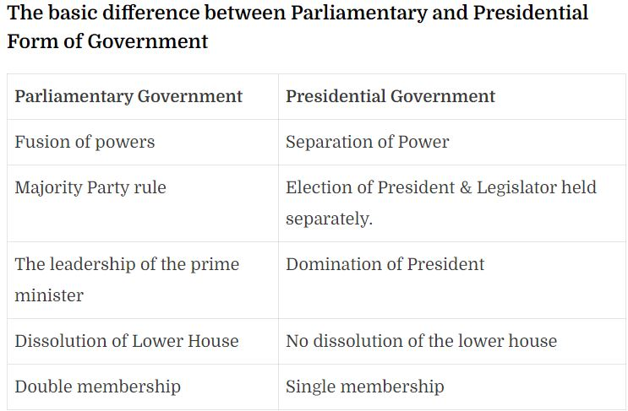

Slide 16
6. Integrated and Independent Judiciary: India has an integrated Judiciary, that is, a single Judicial System for the implementation of state and union laws. Unlike in the USA, where state laws and federal laws are enforced by different courts.
The Supreme Court of India is at the top position of the Integrated Judicial System. And, High Courts at state levels with other subordinate courts.
There is a hierarchy of subordinate courts, that is, district courts and other lower courts.
The Supreme Court is the highest court of appeal in India. It is the guardian of the Constitution as well as Guarantor of Fundamental rights.
Hence, the Constitution made various provisions to ensure the independence of the Supreme Court.

Slide 17
7. Fundamental Rights: The concept of Fundamental Rights found its roots in the US Constitution. Experts describe fundamental rights as the Magna Carta of India.
Fundamental Rights are enshrined in Part III of the Indian Constitution from articles 12 to 35.
Originally, there were seven fundamental rights in the Constitution but the right to property was deleted by the 44th amendment act.
However, at present, we have six fundamental rights. which are-
Right to equality (Article 14 to 18),
the Right to freedom (Article 19 to 22),
Right against exploitation (Article 23 & 24),
Right to freedom of religion (Article 25 to 28),
Cultural and educational rights (Article 29 & 30),
Right to constitution remedies (Article 32).

Slide 18
8. Directive Principles of State Policy: Basically, Directive Principles of State Policy are like duties of government.
On the other hand, Fundamental duties (an upcoming salient feature of the Indian Constitution) are the duties of a citizen.
Notably, the Irish Constitution is the inspiration behind Directive Principles.
The Constitution did not want future governments to be bound by certain policy decisions. therefore, DPSPs.
Unlike fundamental rights, directive principles are not legally enforceable by any court of law. in other words, the courts can not force the government to implement DPSPs.
The Directive Principles of state policy are enshrined in Part IV (Article 36 to 51) of the Constitution.

Slide 19
9. Fundamental Duties: The fundamental duties are inspired by the Constitution of the USSR (now Russia).
Interestingly, these were not part of the original constitution. but added by the 42nd Constitutional Amendment Act of 1976.
Under this amendment of 1976, a new part IVA (Article 51A) was added for fundamental duties.
However, fundamental duties are also not legally enforceable by courts. in other words, Citizens are not bound to follow fundamental duties. They are more or less guidelines for a better citizen.

Slide 20
10. Universal Adult Franchise: The Constitution adopts the Universal Adult Franchise for elections of Lok Sabha and the State Legislative Assembly.
This means that a person having an age of 18 years or more can not be denied the voting right. So no one can be discriminated on the basis of caste, religion, race, sex, wealth, and so on.
Though this age limit was 21 years before 1989. It was changed with the 61st Constitutional Amendment Act 1988.

Slide 21
11. Single Citizenship: The Indian Constitution does not have any provisions of dual citizenship rather it provides for single citizenship.
On the other hand, countries like the United States of America has a system of dual citizenship (National and state citizenship).
So this means that citizens of different states will enjoy different sets of rights.
12. Secular State: As per the Constitution, India is a secular state.
Hence, it does not recognize any particular religion as the official religion of the Indian state.
Therefore, it gives equal respect to every religion.

Slide 22
PREAMBLE TO THE CONSTITUTION
The Preamble of the Indian Constitution states:
“WE, THE PEOPLE OF INDIA, having solemnly resolved to constitute India into a SOVEREIGN SOCIALIST SECULAR DEMOCRATIC REPUBLIC and to secure to all its citizens
JUSTICE, social, economic and political;
LIBERTY of thought, expression, belief, faith, and worship;
EQUALITY of status and of opportunity; and to promote among them all
FRATERNITY assuring the dignity of the individual and the unity and integrity of the Nation;
IN OUR CONSTITUENT ASSEMBLY this 26th day of November 1949, do HEREBY ADOPT, ENACT AND GIVE TO OURSELVES THIS CONSTITUTION”.

Slide 23
WHAT IS A PREAMBLE?
A preamble of a bill is an introductory part of the document which explains the purpose, rules, regulations, and philosophy of the document.
A preamble gives a brief introduction of documents by highlighting the principles and fundamental values of the document. It shows the source of the authority of the document.
The preamble of the Constitution of India is an introduction of the Constitution which includes the sets of rules and regulations to guide the people of the country.
The inspiration and the motto of the citizens are explained in it.
The preamble can be considered as the beginning of the Constitution which highlights the base of the Constitution.

Slide 24
HISTORICAL BACKGROUND OF INDIAN CONSTITUTION
Before 1947, India was divided into two main parts – 11 provinces that were ruled by the Britishers and Princely states ruled by Indian princes under the command of Britishers.
Combining these two units formed the Union of India. The preamble is based on the principles written by the Constituent Assembly.
It provides a way of life, which includes fraternity, liberty, and equality as the notion of a happy life and which can not be taken from each other.
Liberty, equality, and fraternity and connected with each other and they can not be separated, which means without equality, liberty would produce the supremacy of the minority over the majority.
Equality without liberty would kill individual perception.
And fraternity helps liberty and equality in their course of action.

Slide 25
WHO WROTE THE PREAMBLE OF INDIA AND DATE OF ITS ADOPTION
The Preamble of the Indian Constitution is primarily based on the ‘Objective Resolution’ written by Jawaharlal Nehru.
He introduced his objective resolution on December 13, 1946, later it was accepted by the Constituent Assembly on 22 January 1947.
The drafting committee observed that the preamble must be limited in defining the important features of the new state and its socio-political objectives and other important matters should be refined further in the Constitution.
The committee changed the motto from ‘Sovereign Independent Republic’ to ‘Sovereign Democratic Republic’ as it was mentioned in the ‘Objective Resolution’.

Slide 26
The preamble can also be called the soul of the constitution as it has everything about the constitution.
It was adopted on 26th November 1949 and it was started from 26th January 1950 also known as the Republic Day.

Slide 27
Components of Preamble of the Indian Constitution
The components of the preamble are:
The preamble shows that the people of India are the source of authority. It means power lies with the citizens to elect their representatives and they also have the right to criticize their representatives.
It comprises the date of its adoption which is November 26th, 1949.
It states the objectives of the Constitution of India, which are justice, liberty, equality, and fraternity to maintain the integrity and unity of the nation as well as the citizens.
It also justifies the nature of the Indian State, which is Sovereign, Socialist, Republic, Secular, and Democratic.

Slide 28
OBJECTIVES OF THE INDIAN CONSTITUTION
The main objective of the Indian Constitution is to promote harmony throughout the nation. As we know, the Constitution is the supreme law and it helps to maintain integrity in the society and to promote unity among the citizens to build a great nation.
The factors which help in achieving this objective are:
Justice
The term ‘Justice’ comprises of three elements that complete the definition, which is social, economic, and political. Justice among the citizens is necessary to maintain order in society. Justice is promised through various provisions of Fundamental Rights and Directive Principles of State Policy provided by the Constitution of India.

Slide 29
Equality
The term ‘Equality’ means no section of society has any special privileges and all the people have given equal opportunities for everything without any discriminations. It means removing all types of discriminations from society to build a healthy environment for the people to live in. Everyone is equal before the law.
Liberty
The term ‘Liberty’ means freedom for the people to choose their way of life, have political views and behavior in society. It means no unreasonable restrictions can be imposed on the citizens in terms of their thoughts, feelings, and views. But liberty does not mean freedom to do anything, a person can do anything but in the limit set by the law. Anything which can create public disorder can not come under liberty. These limits are set by the Constitution to avoid injuries in the name of liberty.

Slide 30
Fraternity
The term ‘Fraternity’ means a feeling of brotherhood and an emotional attachment with the country and all the people. It refers to a feeling which helps to believe everyone is the children of the same soil and are connected with each other. Brotherhood is above social norms or regulations, it is the relationship above caste, age, or gender. Fraternity helps to promote dignity and unity in the nation.

Slide 31
Key Words in The Preamble
Sovereign
The preamble of the Constitution states that India is a Sovereign State. The term ‘Sovereign’ means the independent authority of the state. It means the state has control over every subject and no other authority or external power has control over it. So, the legislature of our country has the powers to make laws in the country with restrictions keeping in mind imposed by the Constitution.
Socialist
The term ‘Socialist’ was added after the 42nd Amendment, 1976, during the emergency. The term socialist denotes democratic socialism. It means a political-economic system that provides social, economic, and political justice.

Slide 32
Secular
The term ‘Secular’ was also added by the 42nd Amendment Act, 1976, during the emergency. The Constitution states India as a secular state as the state has no official religion. The citizens have their own view of life and can choose their religion as they like. The state provides full freedom to the people to practice any religion of their choice. The state treats all religions equally, with equal respect and can not discriminate between them. The state has no right interfering with the people with their choice of religion, faith or idol of worship.
Democratic
The term ‘Democratic’ is derived from the Greek words where ‘demos’ means ‘people’ and ‘Kratos’ means ‘authority’. Which concludes that the government is constructed by the people. India is a democratic state as the people elect their government at all levels, that means, union, state, and local or ground level. Everyone has the right to vote irrespective of their caste, creed or gender. So, in a democratic form of government, every person has a direct or indirect share in administration.

Slide 33
Republic
India has a republic form of government as the head of state is elected and not a hereditary monarch like a king or queen. The term ‘Republic’ is obtained from ‘res publica’ that means public property or commonwealth. It means the power to elect the head of the state for a fixed term lies within the people. So, in conclusion, the word ‘republic’ shows a government where the head of state is elected by the people rather than any birthright.

Slide 34
Fundamental Rights
Articles 12-35 of Indian Constitution deal with Fundamental Rights. These human rights are conferred upon the citizens of India for the Constitution tells that these rights are inviolable. Right to Life, Right to Dignity, Right to Education etc. all come under one of the six main fundamental rights.
Fundamental rights are a very important topic in the polity section of the UPSC exam. It is a basic static portion of the syllabus but it is highly dynamic in the sense that it is featured in the daily news in some form or the other.

Slide 35
What are the Fundamental Rights?
Fundamental rights are the basic human rights enshrined in the Constitution of India which are guaranteed to all citizens. They are applied without discrimination on the basis of race, religion, gender, etc. Significantly, fundamental rights are enforceable by the courts, subject to certain conditions.
Why are they called Fundamental Rights?
These rights are called fundamental rights because of two reasons:
They are enshrined in the Constitution which guarantees them
They are justiciable (enforceable by courts). In case of a violation, a person can approach a court of law.

Slide 36
List of Fundamental Rights
There are six fundamental rights of Indian Constitution along with the constitutional articles related to them are mentioned below:
Right to Equality (Article 14-18)
Right to Freedom (Article 19-22)
Right against Exploitation (Article 23-24)
Right to Freedom of Religion (Article 25-28)
Cultural and Educational Rights (Article 29-30)
Right to Constitutional Remedies (Article 32)

Slide 37
Introduction to Six Fundamental Rights (Articles 12 to 35)
1. Right to Equality (Articles 14 – 18)
Right to equality guarantees equal rights for everyone, irrespective of religion, gender, caste, race or place of birth. It ensures equal employment opportunities in the government and insures against discrimination by the State in matters of employment on the basis of caste, religion, etc. This right also includes the abolition of titles as well as untouchability.
2. Right to Freedom (Articles 19 – 22)
Freedom is one of the most important ideals cherished by any democratic society. The Indian Constitution guarantees freedom to citizens. The freedom right includes many rights such as:
Freedom of speech
Freedom of expression
Freedom of assembly without arms
Freedom of association
Freedom to practice any profession
Freedom to reside in any part of the country

Slide 38
Some of these rights are subject to certain conditions of state security, public morality and decency and friendly relations with foreign countries. This means that the State has the right to impose reasonable restrictions on them.
3. Right against Exploitation (Articles 23 – 24)
This right implies the prohibition of traffic in human beings, begar, and other forms of forced labour. It also implies the prohibition of children in factories, etc. The Constitution prohibits the employment of children under 14 years in hazardous conditions.

Slide 39
4. Right to Freedom of Religion (Articles 25 – 28)
This indicates the secular nature of Indian polity. There is equal respect given to all religions. There is freedom of conscience, profession, practice and propagation of religion. The State has no official religion. Every person has the right to freely practice his or her faith, establish and maintain religious and charitable institutions.
5. Cultural and Educational Rights (Articles 29 – 30)
These rights protect the rights of religious, cultural and linguistic minorities, by facilitating them to preserve their heritage and culture. Educational rights are for ensuring education for everyone without any discrimination.

Slide 40
6. Right to Constitutional Remedies (32 – 35)
The Constitution guarantees remedies if citizens’ fundamental rights are violated. The government cannot infringe upon or curb anyone’s rights. When these rights are violated, the aggrieved party can approach the courts. Citizens can even go directly to the Supreme Court which can issue writs for enforcing fundamental rights.

Slide 41
FEATURES OF FUNDAMENTAL RIGHTS
Fundamental rights are different from ordinary legal rights in the manner in which they are enforced. If a legal right is violated, the aggrieved person cannot directly approach the SC bypassing the lower courts. He or she should first approach the lower courts.
Some of the fundamental rights are available to all citizens while the rest are for all persons (citizens and foreigners).
Fundamental rights are not absolute rights. They have reasonable restrictions, which means they are subject to the conditions of state security, public morality and decency and friendly relations with foreign countries.

Slide 42
They are justiciable, implying they are enforceable by courts. People can approach the SC directly in case of violation of fundamental rights.
Fundamental rights can be amended by the Parliament by a constitutional amendment but only if the amendment does not alter the basic structure of the Constitution.
Fundamental rights can be suspended during a national emergency. But, the rights guaranteed under Articles 20 and 21 cannot be suspended.
The application of fundamental rights can be restricted in an area that has been placed under martial law or military rule.

Slide 43
FUNDAMENTAL RIGHTS AVAILABLE ONLY TO CITIZENS
The following is the list of fundamental rights that are available only to citizens (and not to foreigners):
Prohibition of discrimination on grounds of race, religion, caste, gender or place of birth (Article 15).
Equality of opportunity in matters of public employment (Article 16).
Protection of freedom of:(Article 19)
Speech and expression
Association
Assembly
Movement
Residence
Profession

Slide 44
4. Protection of the culture, language and script of minorities (Article 29).
5. Right of minorities to establish and administer educational institutions (Article 30).

Slide 45
IMPORTANCE OF FUNDAMENTAL RIGHTS
Fundamental rights are very important because they are like the backbone of the country.
They are essential for safeguarding the people’s interests.
According to Article 13, all laws that are violative of fundamental rights shall be void.
Here, there is an express provision for judicial review.
The SC and the High Courts can declare any law unconstitutional on the grounds that it is violative of the fundamental rights.
Article 13 talks about not just laws, but also ordinances, orders, regulations, notifications, etc.

Slide 46
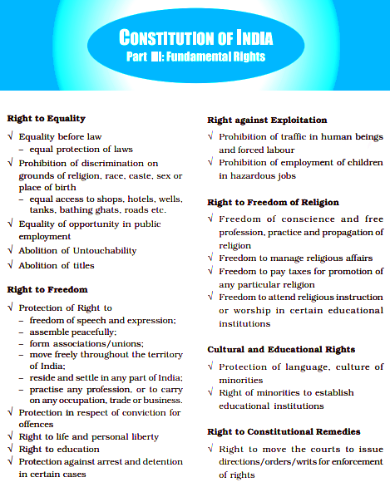

Slide 47
AMENDABILITY OF FUNDAMENTAL RIGHTS
Any changes to the fundamental rights require a constitutional amendment that should be passed by both the Houses of Parliament. The amendment bill should be passed by a special majority of Parliament.
As per the Constitution, Article 13(2) states that no laws can be made that take away fundamental rights.
The question is whether a constitutional amendment act can be termed law or not.
In the Sajjan Singh case of 1965, the Supreme Court held that the Parliament can amend any part of the Constitution including fundamental rights.
But in 1967, the SC reversed its stance taken earlier when in the verdict of the Golaknath case, it said that the fundamental rights cannot be amended.

Slide 48
In 1973, a landmark judgement ensued in the Kesavananda Bharati case, where the SC held that although no part of the Constitution, including Fundamental Rights, was beyond the Parliament’s amending power, the “basic structure of the Constitution could not be abrogated even by a constitutional amendment.”
This is the basis in Indian law in which the judiciary can strike down any amendment passed by Parliament that is in conflict with the basic structure of the Constitution.
In 1981, the Supreme Court reiterated the Basic Structure doctrine.
It also drew a line of demarcation as April 24th, 1973 i.e., the date of the Kesavananda Bharati judgement, and held that it should not be applied retrospectively to reopen the validity of any amendment to the Constitution which took place prior to that date.

Slide 49
Criticism of Fundamental Rights
The Fundamental Rights have been criticised for many reasons.
Political groups have demanded that the right to work, the right to economic assistance in case of unemployment, old age, and similar rights be enshrined as constitutional guarantees to address issues of poverty and economic insecurity, though these provisions have been enshrined in the directive principles of state policy.
The right to freedom and personal liberty has a number of limiting clauses, and thus have been criticized for failing to check the sanctioning of powers often deemed "excessive".
There is also the provision of preventive detention and suspension of Fundamental Rights in times of Emergency.

Slide 50
The provisions of acts like MISA (Maintenance of Internal Security Act) and NSA (National Security Act) are a means of countering the fundamental rights, because they sanction excessive powers with the aim of fighting internal and cross-border terrorism and political violence, without safeguards for civil rights.
The phrases "security of State", "public order" and "morality" are of wide implication.
The meaning of phrases like "reasonable restrictions" and "the interest of public order" have not been explicitly stated in the constitution, and this ambiguity leads to unnecessary litigation.
The freedom to assemble peaceably and without arms is exercised, but in some cases, these meetings are broken up by the police through the use of non-fatal methods.

Slide 51
Conclusion
The fundamental rights have been included in the Constitution because they were considered to be essential for the development of the personality of each and every individual and are there to preserve human dignity and respect.
Most of these rights are enforceable against the state by way of their language while some of these rights can be directly enforced against both the state as well as, a private individual.
One of the most important aspects of the fundamental rights is that it gives Judiciary clear criteria as to how the regulation of relations between the citizens and the government will take place.

Slide 52
Because of the existence of these rights and their enforceability in the court people can freely enjoy their life and personal liberty, they can move from one part of the country to another, they can assemble peacefully, etc.
However, these fundamental rights are also criticised by many as some of the words or phrases used in defining these fundamental rights are found to be vague by many or their meaning is not defined anywhere else in the Constitution of India.
Words or phrases such as, ‘public order’, ‘minorities’, etc. belong to this category.

Slide 53
Another positive aspect of the Fundamental rights is that these empower the young children of our nation as they are granted the right to receive free education up to the age of 14.
The fundamental rights may have flaws but it does provide more protection to the citizens of the nation than most of its ‘shortcomings’.

Slide 54
DIRECTIVE PRINCIPLES OF STATE POLICY
The Directive Principles of State Policy (DPSP) has been taken from the Irish constitution and enumerated in Part IV of the Indian Constitution.
The concept behind the DPSP is to create a ‘Welfare State’. In other words, the motive behind the inclusion of DPSP is not establishing political democracy rather, it’s about establishing social and economic democracy in the state.
These are some basic principles or instructions or guidelines for the government while formulating laws/policies of the country and in executing them.

Slide 55
According to Dr B R Ambedkar, these principles are ‘novel features’ of the Constitution. DPSP acts as a guideline for the state and should be taken into consideration while coming up with some new policy or any law.
But no one can compel the State to consider and follow all that which is mentioned in DPSP, as DPSP is not justiciable.

Slide 56
HISTORY OF DPSPs
The source of the concept of DPSP is the Spanish Constitution from which it came in the Irish Constitution. The makers of the Indian Constitution were very much influenced by the Irish nationalist movement and borrowed this concept of DPSP from the Irish Constitution in 1937.
The Directive Principles of the Constitution of India have been greatly influenced by the Directive Principles of Social Policy.
DPSP become an inspiration for independent India’s government to tackle social, economic and various other challenges across a diverse nation like India.

Slide 57
Justifiable rights, the one which was enforceable in a court of law and included in Part III of the Constitution.
On the other hand, Non-justifiable rights were listed as directive principles, which are just there to guide the state to work on the lines for making India a welfare state.
They were included in part IV of the Constitution of India as Directive Principles of State Policy.
Both the Fundamental Rights and the DPSP were enlisted in all the drafts of the constitution (I, II and III) prepared by the Drafting Committee whose chairman was Dr. B.R. Ambedkar.

Slide 58
SOURCES
The DPSP of the Indian Constitution was inspired by the Irish Constitution which took these details from Spain.
Some Instruments of Instructions, which also became the immediate source of DPSP, have been taken from the Government of India Act, 1935.
Another source was the Sapru Report, 1945 which gave us both Fundamental Rights (justiciable) and DPSP(s) (non-justiciable).

Slide 59
REFLECTION OF PREAMBLE
The Preamble is a brief introduction to the constitution and it contains all the objectives which were there in the mind of the drafters of the Indian Constitution.
According to some scholars, DPSP is ‘the kernel of the Indian Constitution’.
The Directive Principles of the State Policy (DPSP) are the guidelines for the state which it must consider while formulating new laws and policies and it lay down all the objectives which the Constitution seeks to achieve.
The expression “Justice – Social, economic and political” that is mentioned in the preamble is the ultimate aim that has to be achieved through the formulation of the DPSP.

Slide 60
DPSP are enlisted to attain this ultimate aim as mentioned in the preamble i.e. Justice, Liberty, Equality and fraternity are also known as the four pillars of the Indian Constitution.
It also enlists the idea of the welfare state which was absent under the colonial rule.

Slide 61
FEATURES
DPSP are not enforceable in a court of law.
They were made non-justifiable considering that the State may not have enough resources to implement all of them or it may even come up with some better and progressive laws.
It consists of all the ideals which the State should follow and keep in mind while formulating policies and enacting laws for the country.
The DPSPs are like a collection of instructions and directions, which were issued under the Government of India Act, 1935, to the Governors of the colonies of India.

Slide 62
It constitutes a very comprehensive economic, social and political guidelines or principles and tips for a modern democratic State that aimed towards inculcating the ideals of justice, liberty, equality and fraternity as given in the preamble.
The Preamble consists of all the objectives that needs to be achieved through the Constitution.
Adding DPSP was all about creating a “welfare state” which works for the individuals of the country which was absent during the colonial era.

Slide 63
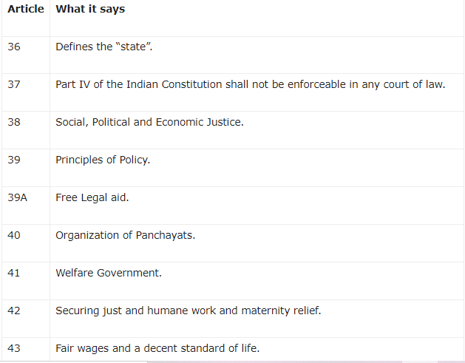
List of Directive Principles of State Policy

Slide 64
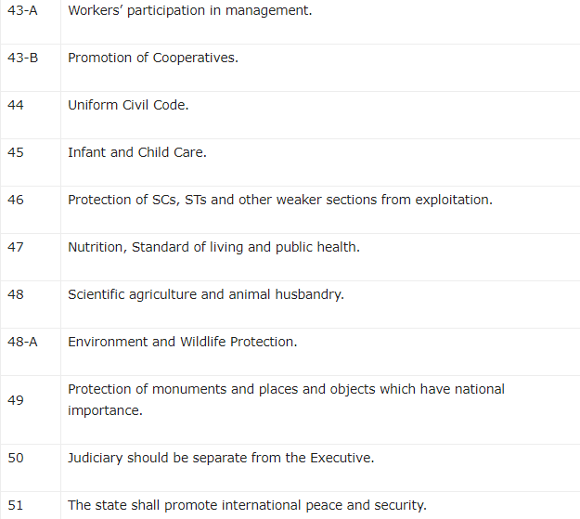

Slide 65
ENFORCEABILITY OF DPSPs
DPSP were not made enforceable by the Constituent Assembly which was formed to draft the Indian Constitution.
But the non-enforceability of the Principles does not mean that they are of no importance.
There are some arguments which are in favor of its enforceability and some are against the making of DPSP enforceable.
Those who favor the enforcement of the Principles argue that enforceability of DPSPs will keep a check on the Government and would unite India.

Slide 66
For instance, Article 44 of the Indian Constitution talks about the Uniform Civil Code which aims for uniform provisions of civil law for all the citizens of the country irrespective of their caste, creed, religion or beliefs.
People who are against the enforcement of the DPSPs are of the view that these principles need not be separately enforced as there are already many laws which indirectly implements the provisions mentioned in DPSP.
For instance, Article 40 of the Constitution which deals with Panchayati Raj system was introduced through a constitutional amendment, and it is very evident that there are numerous panchayats exist in the country today.

Slide 67
Another argument against DPSP is that it imposes morals and values on the citizens of the country.
It should not be clubbed with the law as it is really important to grasp that law and morals area unit various things.
If we impose one on the opposite that will generally impede the expansion and development of the society.

Slide 68
IMPORTANCE OF DPSP
DPSP covers the Articles 36-51 in Part IV of the constitution.
It mentions protection of women of the country, environmental conservation, rural growth and development, decentralisation of power, uniform civil code, etc. which are considered some of the essentials in making laws for a “welfare state”.
Although non-justiciable, they provide a set of guidelines for the Government for its functioning in the country.

Slide 69
SIGNIFICANCE OF DPSP
Directive Principles are non-justiciable but these are backed by vox populi (voice of the people), which is the real sanction behind every law in reality.
DPSP gives the philosophical foundations of a welfare system.
These principles makes it a responsibility of the State to secure it through welfare legislation.
Their nature is more of moral ideals.
They constitute a moral code for the State but this does not reduce their value as moral principles are very important and the absence of it may hamper the growth of a society.
A state is run by its people and the Government is always formed and managed by them, so it’s really important to have a set of standards for making laws in the country.

Slide 70
Directive Principles act as a guide for the government which helps them in making policies and laws for the purpose of securing justice and welfare in the State.
DPSP are like a source of continuity in the Governance of the country because in a democratic system, the Governments change after regular elections and every new government makes different policies and laws for the country.
The presence of such guidelines is really important because it ensures that every Government will follow the set of principles in the form of DPSP while formulating its laws.

Slide 71
Directive Principles can be called as the positive directions for the State which helps in securing social and economical dimensions of democracy.
DPSP are supplementary to Fundamental Rights which offers political rights and other freedoms.
They both are nothing without each other as one provides social and economic democracy and the other, political rights.
Directive Principles of State Policy make it possible for people to measure the worth of a government and its working.
A Government which doesn’t consider these principles can be rejected on this ground by the people in favour of a government which gives due importance to the task of securing these Directive Principles in the state.

Slide 72
The Directive Principles constitute a manifesto of a Nation. These reflect the ideas and views which were there in the mind of the drafters while drafting the constitution.
These reflected the philosophy behind the making of the Constitution and hence provide useful information to the courts in interpreting the existing provisions in the Constitution and in coming up with better laws and policies.
The Directive Principles do not seem to be very rigid in their meanings and this helps the State in interpreting and applying these principles in accordance with the situation prevailing at a given time.

Slide 73
Thus, the inclusion of Part IV which contains the Directive Principles of State Policy proved to be very useful for the country.
The Directive Principles provide good foundations for welfare state.
The securing of Directive Principles helped in completing the requirements of a democratic system.
It supplemented the Fundamental Rights of the people and built a State characterized by these four pillars – Justice, Liberty, Equality, and Fraternity.

Slide 74
Implementation of Directive Principles of State Policy
There are some acts and policies from 1950 onwards which had been implemented to give effect to these Directive Principles.
They are as follows:
The Minimum Wages Act (1948)
Child Labour Prohibition and Regulation Act (1986)
The Maternity Benefit Act (1961)
Equal Remuneration Act (1976)

Slide 75
Handloom Board, Handicrafts Board, Coir Board, Silk Board, etc. have been set up for the development of cottage industries in the country.
Integrated Rural Development Programme (1978)
Jawahar Rozgar Yojana (1989)
Swarnajayanti Gram Swarozgar Yojana (1999)
Sampoorna Gram Rozgar Yojana (2001)
Mahatma Gandhi National Rural Employment Guarantee Programmes (2006)
The National Forest Policy (1988)
Article 21-A was inserted by the 86th amendment, making free education for children below the age of 14 compulsory.
Prevention of Atrocities Act safeguarding the interests of SCs and STs.
Several Land Reform Acts.

Slide 76
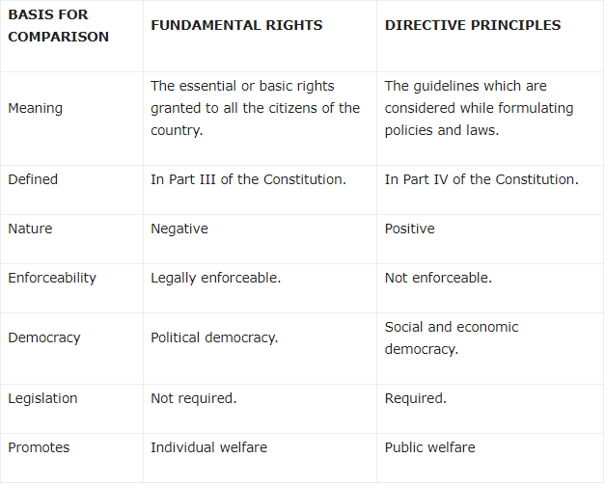
Comparison between DPSP and Fundamental rights

Slide 77
Criticism of Directive Principles of State Policy
Some of its critics hold that these principles don’t carry any importance as their violation can’t be challenged in the courts.
The Directive Principles are a mere declaration of the instructions which are to be observed and secured by the State at will but the Constitution neither makes them justiciable nor it mentions any limit to what extent it can be secured.
These are neither consistently explicit nor properly classified. These appear to be a collection of instructions which are only based on morals and a State can’t rely merely on morals for its working.

Slide 78
Part IV includes some directives which are not complete in actual observation.
The ideal is to introduce prohibition but this ideal cannot be really and effectively realised.
The states which introduced prohibition had to scrap it later on.
Most of the Directive Principles are based on old and foreign philosophy which have lost its relevance now.
Many critics hold that the Preamble should also enlists all these goals which are given under DPSP and their description in Part IV has made things more complicated and complex than it was before.
Directive principles just create an impression about the usage of the legitimate power by the State and the motive is to gain support through promise-making and not through inaction .

Slide 79
CONCLUSION
The significance of DPSPs cannot be looked down upon just because it is not enforceable in any court of law.
These principles were added to facilitate the governance and smooth functioning of the country.
It was added to meet the main objectives and the ultimate goal of a country i.e to work for the welfare of its citizens.
There are some important Acts in the above-mentioned information, so we can’t say that DPSPs are not implemented and have no importance at all.
It is like a structure given for the government and it should work and formulate new laws revolving around that structure only so that the welfare of the people be ensured.

Slide 80
Every policy and law formulated by the state has to meet the standards which are mentioned in Part IV of the Constitution.
Thus, even after being non-justiciable they are implemented in some important Acts and they hold equal relevance and importance as Fundamental rights mentioned in Part III of the Constitution of India.

Slide 81
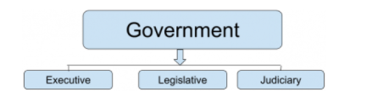
UNION EXECUTIVES: PRESIDENT, PRIME MINISTER, PARLIAMENT AND SUPREME COURT
Parliamentary form of Government
Before talking of the Parliament and Union Executive, let us understand the form and nature of the Indian government.
The Structure of the Indian government can be understood by the following flow chart:

Slide 82
India is a form of Parliamentary Government.
It is a form of government in which the executive is responsible and answerable to the legislative.
It is also called the Cabinet Government due to the concentration of executive powers in the Cabinet.
The Executive is a part of the Legislative.
This form of government was basically preferred by the leaders as:

Slide 83
Leaders were aware of such a form of government.
This government was considered a more responsible government as in this form of government, the executive is answerable to legislative and the legislative is answerable to the citizens.
This type of government prevents Authoritarianism.
This form helps to get representation from a Diverse Group of people.
This form of government remains laden with the availability of Alternate Government.
In this form of government, the head of the state holds a ceremonial position and is the nominal executive. For example, the President
The real head of the State is the Prime Minister, who is the real executive.
There is a majority party rule in such a form of government.
There is always a Parliamentary Opposition to maintain a check on the actions of the ruling government.

Slide 84
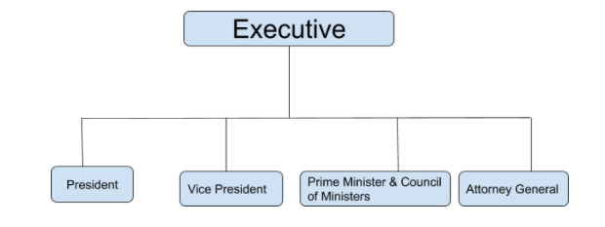
If we dwell deep inside, we find further subdivision of the Executive Organs of the State.
These subdivisions are:

Slide 85
The President (Article 52)
The first and foremost part of the Executive is the President. Article 52 states that there shall be a President of India.
The President is considered the Executive head of the country.
All the Executive business of the country is carried out in the name of the President.
So the question arises that if President is the executive head and all actions are in his name, and the President has to carry out many functions, then can there be the performance of an act not mentioned in any specific legislation by the Executive?

Slide 86
The same was answered in the case of Ram Jawaya Kapoor v. the State of Punjab, the Government invited textbooks from authors for approval.
When textbooks were approved, the authors were made to enter an agreement.
According to this agreement, the copyright of these books vested solely in the Government.
The authors only got 5% royalty on the sale of the textbooks.
The Government took all the publishing, printing and selling rights of the books in their own hands.

Slide 87
The Court held that these provisions were ultra-vires to the constitutional power.
The government being an executory body did not possess the power to enter into that activity or trade without specific legislations.
No restriction on the executive powers is defined in the Indian Constitution.
The Court held that the executive cannot be restricted to mere implementations of legislations.
There is a strict separation of powers but no strict separation of functions.

Slide 88
Qualifications: Article 58
After knowing that President is the Executive Head of the entire nation, you might too aspire to become a president.
So let’s analyze the eligibility and all the specific requirements, you would be needing to become the President of India?
Article 58 talks about the eligibility of a person to become President of India.
It says that a person is eligible for election as President if he:
is a citizen of India;
has completed the age of thirty-five years;
is qualified for election as a member of the House of the People.

Slide 89
A person can be disqualified for election as President if he holds any office of profit under
the Union of India or;
the Government of any State or;
under any local or other authority subject to the control of any Government of India.

Slide 90
Condition of President’s Office: Article 59
The eligibility to become the President might seem simple but the conditions his office are quite strict.
Article 59 of the Indian Constitution talks about the conditions of the President’s office.
It says:
The President cannot be a member of either House of Parliament or of any other House of the Legislature of any State.
If he is a member of either House of Parliament or a member of a House of the Legislature of any State, he will need to vacate his seat in that House on the date of entering into his office as President.

Slide 91
Official residence, emoluments, and allowances of President
Apart from all these conditions and rules, you might crave for some advantage of being the President.
Well, the President of India is also entitled to certain allowances and privileges, as he is the first citizen of the country.
The President of India is entitled to rent-free accommodation, allowances, and privileges by law.
He is also entitled to:
Free medical facilities;
Free accommodation;
Free treatment for life;
The official state car of the President.

Slide 92
The salary of the President has undergone several changes since independence. Some of these changes were:
In 1951, the President of India used to get a salary of Rs. 10,000 and 15000 rupees as an allowance.
In 1985, the President of India used to get a salary of Rs. 15,000 and 30000 rupees as an allowance.
In 1989, the President of India used to get a salary of Rs. 20,000 and 10000 rupees as an allowance.
In 1998, the salary was increased to Rs. 50,000.
In 2008, the salary was increased to Rs. 1,50,000.
In 2016, the salary was increased to Rs. 5,00,000.

Slide 93
Election of President: Article 54
The answer lies in Article 54 of the Constitution.
It deals with provisions relating to the election of the President.
It says that the President must be elected by the members of an electoral college.
The electoral college consists of the elected members of both Houses of Parliament and the state Legislative Assemblies.

Slide 94
Mode of Voting
As per Article 55(3) of the Constitution of India, the election of the President should be held according to the system of proportional representation by means of a single transferable vote.
The voting at the presidential election shall be by secret ballot.

Slide 95
Term of office of the President: Article 56
Article 56 defines the term of the office of the President to be of five years unless:
A new President enters the office, the incumbent President shall hold it;
President resigns before the expiry of the term by writing it to the Vice President;
The President is removed from his office, for violation of the Constitution, by the process of impeachment provided under article 61.
The article also states that any resignation made by the President to the Vice President must be communicated to the Speaker of the Lok sabha by the Vice President himself.

Slide 96
Procedure for impeachment of the President: Article 61
The President of India can be impeached under Article 61, for the violation of the Constitution, on the basis of charges preferred by either House of Parliament.
A resolution with the proposal to prefer such charges must be signed by at least one-fourth of the total members of the house.
The resolution also needs to be passed by at least two-thirds majority of the house.
When the resolution is passed by one of the Houses, the other House must investigate the charges.
The President has been granted the right to be present or to be represented in such investigations.

Slide 97
When the House investigating the charges passes the resolution by a two-thirds majority and declares the charges as sustaining, it results in removing the President from his office from the date of passing of the resolution.

Slide 98
Privileges of the President: Article 361
As President, you also enjoy some degree of immunity. Under Article 361, the President is protected from being answerable to any court for:
For exercise and performance of his powers and duties of his office;
For doing any act or claimed of doing any act in the exercise of those powers and duties;
The conduct of the President can be reviewed only if either House of Parliament designates or appoints any court tribunal or any other body to investigate the charges under Article 61.

Slide 99
The Article immunes the President against all types of criminal proceedings during the term of his office.
No issuance of any order relating to the arrest and imprisonment of the President can be made by any court during his term of office.
A civil proceeding can be constituted against the president during his term of office if:
The act is done or alleged to have been done, whether before or entering the office of the President, by him was in his personal capacity;

Slide 100
Two months prior notice is provided, to the president or was sent to his office, stating:
The nature of the proceeding;
The cause of action;
The details of the other party including name, description, and place of residence;
The relief claimed by the other party;

Slide 101
Powers of the President
Executive powers
Article 53 of the Indian Constitution states that all the executive powers of the Union will be vested in the President of India. President is allowed to exercise his executive powers through officers subordinate to him, directly or indirectly, in consonance to the provisions of the Constitution.
Under this article, the President has powers regarding:
Appointment of the high authorities of the Constitution like the Prime Minister and the Council of Ministers;
Right of being informed about all the national affairs;

Slide 102
Appointment of the judges of the constitutional courts(Supreme Court and High Courts);
Appointment of the state Governors, the Attorney General, the Comptroller, and Auditor General, the Chief Commissioner and members of the Election Commission of India;
Administration of Union territories and appointment of the Chief Commissioners and Lieutenant Governor of the Centrally Administered Areas;
Removal of the Council of Ministers, the state Governors, the Attorney General.

Slide 103
Military powers
Article 53 also states that the President shall be the Supreme Commander of all the Armed Forces of the Union of India. It also states that no specific provisions can reduce the scope of this general principle.
As the Supreme Commander of the Armed Forces of the Union, President has powers regarding:
Appointment of all the officers, including the appointment of the chiefs of the forces;
Wars are waged in the name of the President;
Peace is concluded in the name of the President.

Slide 104
Diplomatic powers
The President forms the face of Indian diplomacy and helps the nation to maintain cordial relationships with countries across the globe.
All the Ambassadors and high commissioners in foreign nations are his representatives;
He receives the credentials of the Diplomatic representatives of other nations;
Prior to ratification by Parliament, the treaties and agreements with other nations, are negotiated by the President.

Slide 105
Legislative powers
The President also enjoys certain legislative powers like:
During the budget session, the President is the first to address the Parliament;
The President is empowered to summon a joint session in order to break the deadlock in the legislation process between the two Houses of the Parliament;
President sanction is mandatory in cases of provisions relating to:
creating a new state;
changes in the boundary of existing states;
a change in the name of a state.

Slide 106
Pardoning power: Article 72
Article 72 provides for the provisions relating to the pardoning powers of the President. President can grant pardons, respites, reprieves, and remissions of punishments or remit suspend or commute the sentence given to a person by the court in the following cases:
When the sentence is granted through a court-martial;
When the sentence or punishment is given for offense of violation of any law relating to matters that fall in the ambit of Union’s executive powers;
When a death sentence is passed by a court.

